Slide 1
SCHOOL MANAGEMENT SYSTEM PRESENTATION
USING PYTHON LANGUAGE

Slide 2
Introduction
The system manages and stores student’s details which includes:
Their courses
Their names
Their ID
Their phone numbers
New courses assigned to them

Slide 3
SYSTEM DESIGN - CLASSES
Here the student inherits data labels from person.py created earlier
The student file contents the details of the student
The school management file now shows, stores and manages all information about the student
Person
Student(inherits Person)
Student_id
Course
Name ,phone
(inherited)

Slide 4
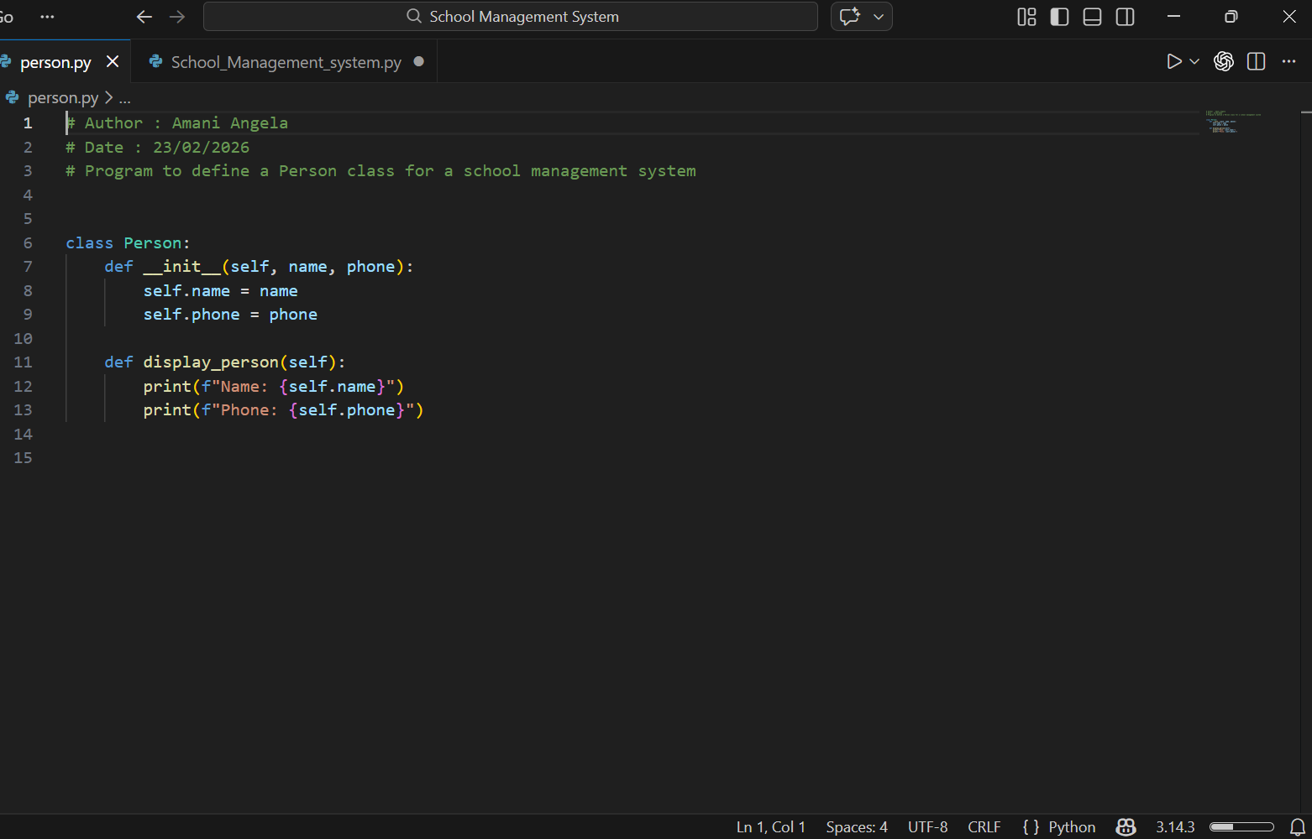
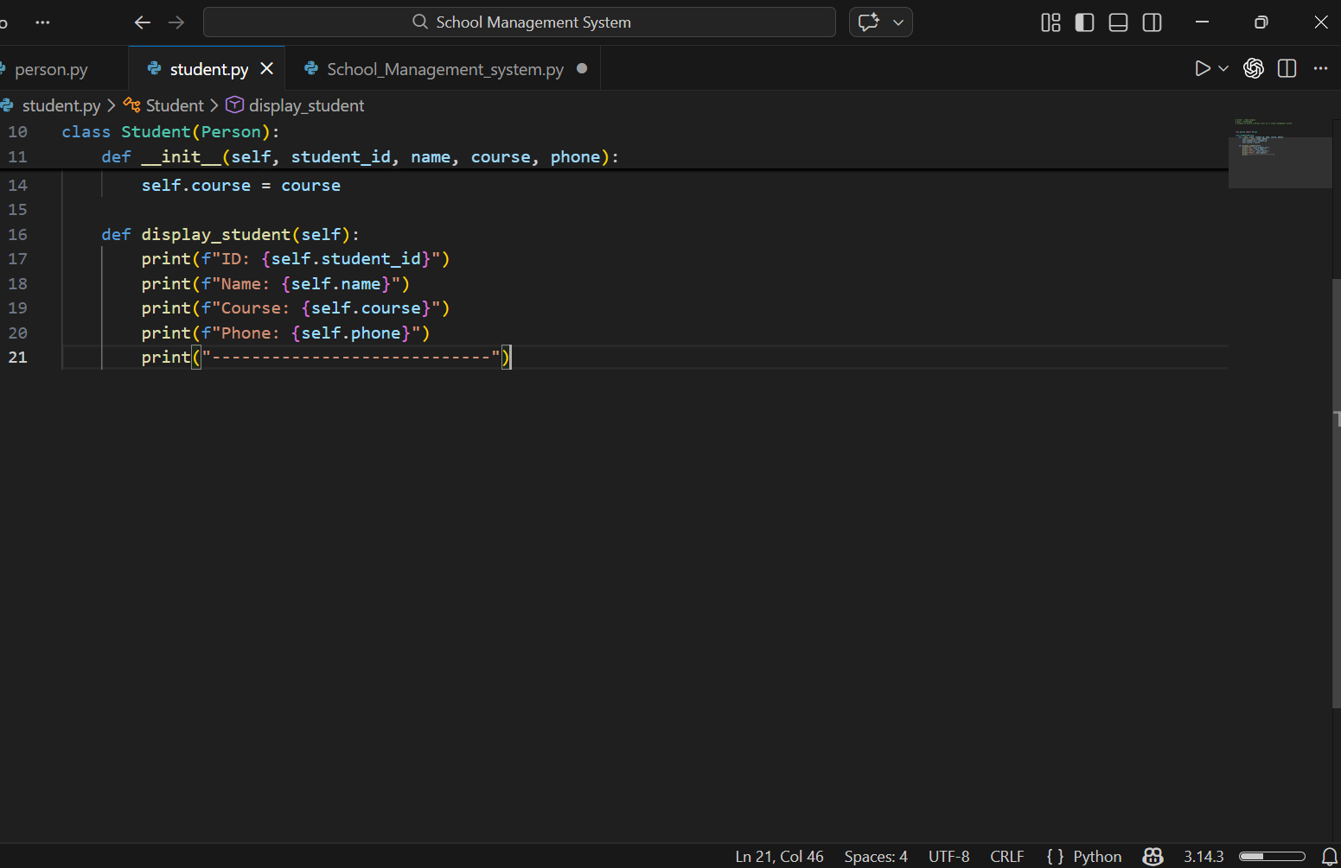
Demo
Of the explanation

Slide 5
MENU AND FUNCTIONALITIES
Main menu has 5 options:
1. Register New Student – add new student details (ID, Name, Course, Phone)
2. Display Students – shows all registered students
3. Assign New Course – update a student’s course
4. Export to Excel – save student data in an Excel file
5. Exit – close the program

Slide 6
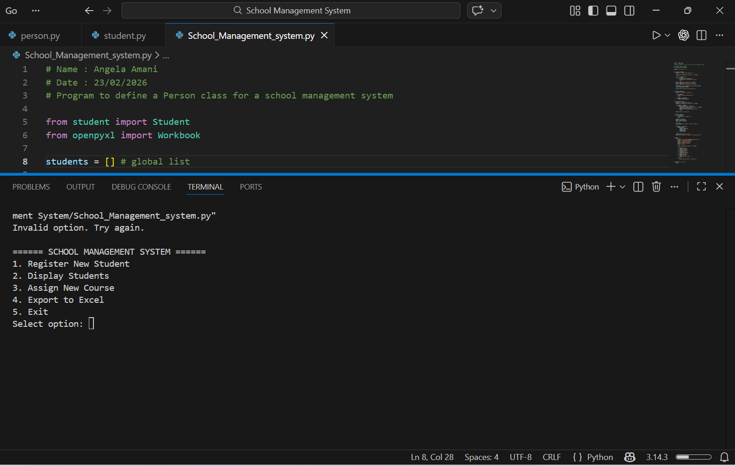

Slide 7
MENU DISPLAYED
USER SELECTS OPTION
FUNCTION RUNS DEPENDING ON CHOICE
Function runs depending | | on choice: | | - Register | | - Display | | - Assign Course | | - Export to Excel
STEP 2
STEP 1

Slide 8
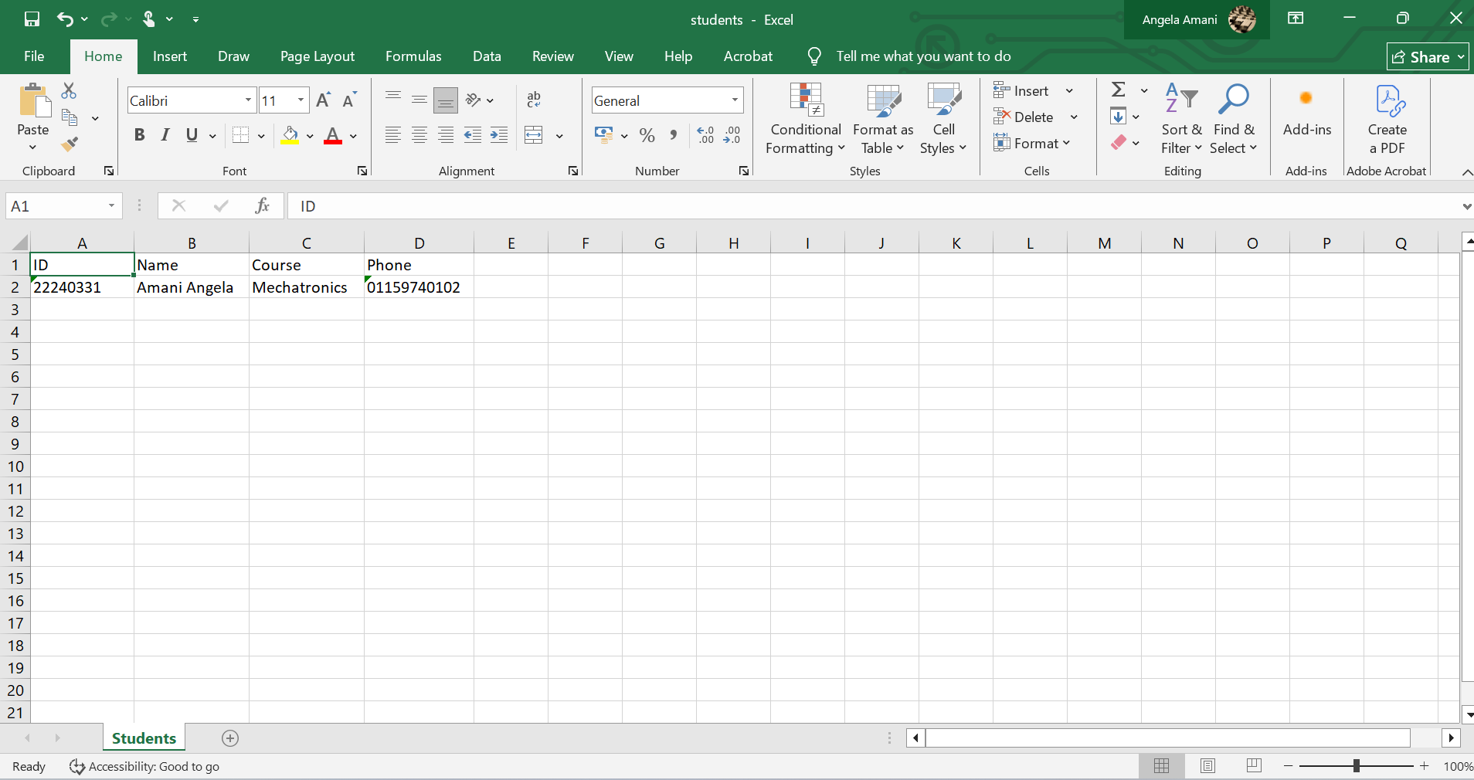
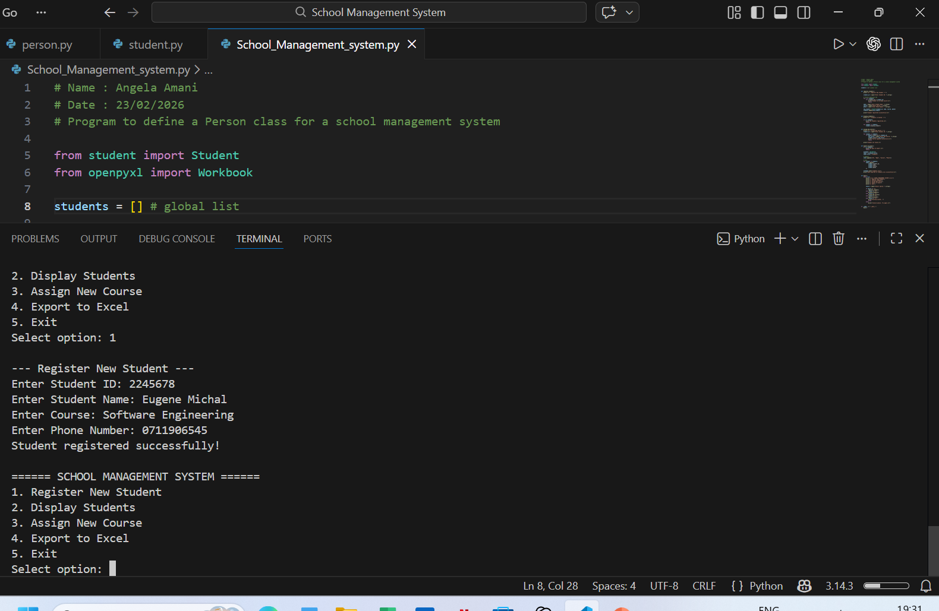
FINAL OUTPUT
INFORMATION OF STUDENT STORES IN EXCEL

